Slide 1
INVOICE GENERATOR
Team members
ID | NAME
2110030031 | Sumeet Sharma
2110030085 | N Manas
2110030115 | Pritish
2110030190 | Karam Sai Vardhan Reddy
2110030252 | Mohammed Afeef Sayeed

Slide 2
ABOUT:
An Invoice creator project built with React.
Add itemized items, configure quantity, prices, tax rates and discounts. Download Invoice as PDFs to your device.
Uses jspdf-react to capture the data from the modal and covert it from canvas -> pdf.

Slide 3
DEPENDENCIES:
react-bootstrap
Jspdf
html2canvas
react-icons

Slide 4
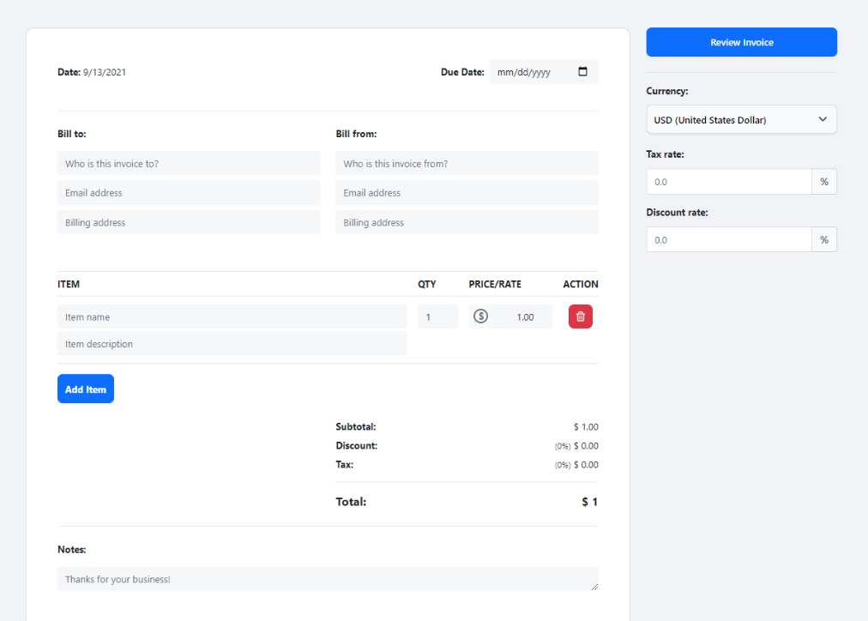

Slide 5
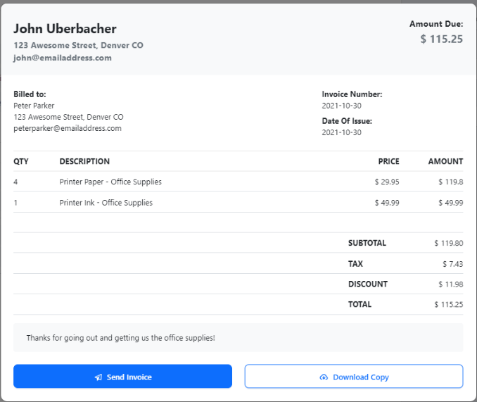

Slide 6
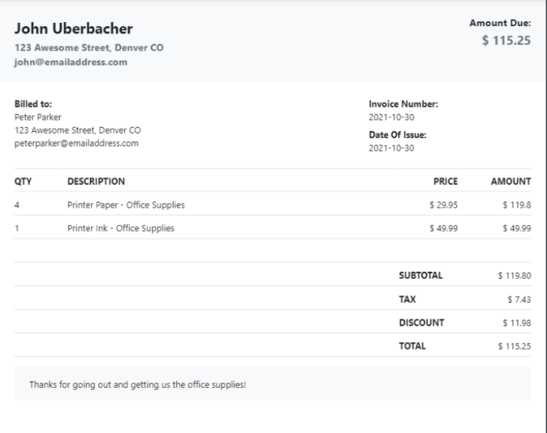
PDF FORM:

Slide 7
THANK YOU

